Slide 1


Masters in Laboratory Animal Science and Animal Welfare
Bibliographic searches
28 November 2014
Mar Sanz Luengo
Presentation: Carmen Muñoz Serrano
Complutense University of Madrid
School of Veterinary Medicine. Library
http://www.flickr.com/photos/91155980@N07/10987266585/

Slide 2
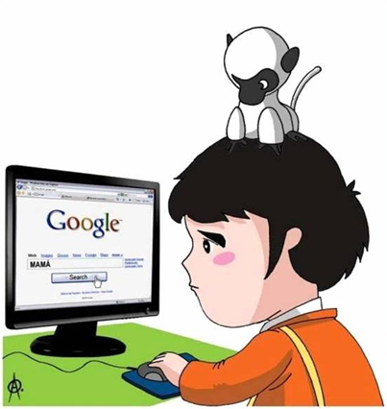



Sources of information
Searching Strategies
How to organize information
Information Evaluation
Internet: Google
Library Websites
Databases
E-journals

Slide 3



Sources of information
Searching Strategies
How to organize information
Information Evaluation
Keyword.
Common language
Descriptors and
Thesaurus
English
Boolean Operators

Slide 4




Sources of information
Searching Strategies
How to organize information
Information Evaluation
Reference Managers

Slide 5




Sources of information
Searching Strategies
How to organize information
Information Evaluation
Bibliometric Indicators

Slide 6
Sources of information
Searching Strategies
How to organize information
Information Evaluation
Internet: Google
Library Websites
Databases
E-journals

Slide 7


How to search in google what you need
Searching Tips and Tricks
http://www.google.com/intl/en/insidesearch/tipstricks/all.html
Use advanced search
  http://www.google.com/advanced_search
Use special operators
“…” search for a particular phrase
  “in vitro maturation”
filetype: search for a specific format file
    “in vitro maturation” filetype:pdf
site: to search within a site
    “in vitro maturation” site:ucm.es
Use Verbatim, text-searching
Search for academic publications and received cites in Google Scholar
http://scholar.google.com/
Internet

Slide 8
Google Scholar
Internet
Released in 2004, whose aim is to provide free and universal access to scientific publications.
Recurrent tracking of academic websites.
Scientific documents recovery specialization and identification of each time were cited.
Direct competitors of other cite index such as:Web of Science or Scopus.
Strenghs:
Gratuity: Open Access.
Wide coverage of information sources: repositories, online journals, databases, scientific societies, library catalog, institutes and researching centres, Google Patents, Google Book Project...
Wide portfolio of documentary types: books, journal articles, papers, scientific reports, thesis, preprints...
Constraints:
Limited searching options
Lack of quality control: mixture of recommended and filtered cites with other results where no clean-up was performed.
Lack of metadata normalization in basic references such as authors or institution names

Slide 9
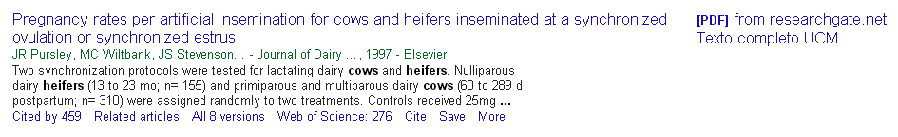
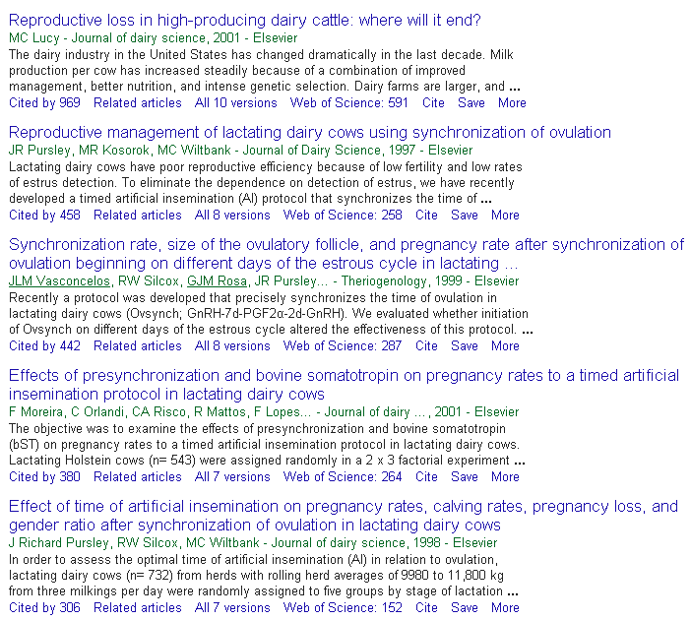
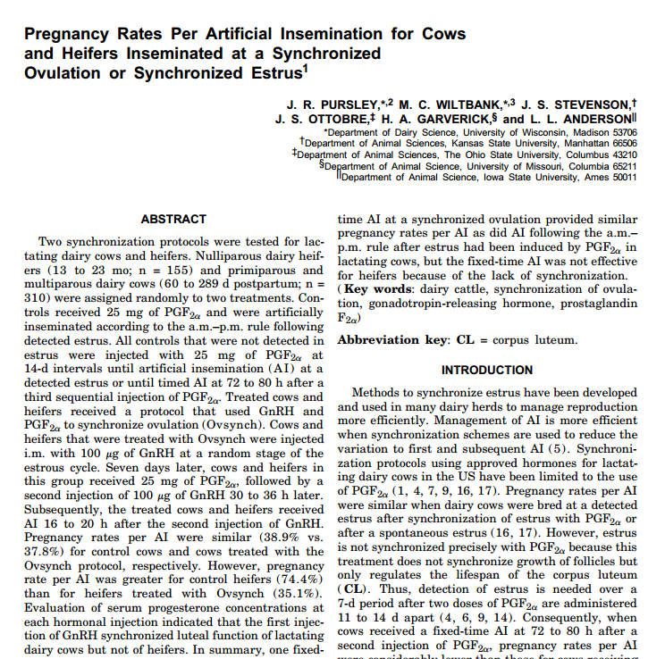
Google Scholar
Internet
Notes:
Full text

Slide 10


Open Access
Internet
Due to limited access to scientific and technical information, Open Access trend appears as solution to overcome such barries
Public and free access to information through internet allowing reading, downloading, copying, distributing, printing, searching or linkage to full text publications without any legal, technical or financial limitation. The only requesite is to keep text integrity and authorship once they are cited.
Open Access does not imply lower scientific quality
Open Access sample:
      Experimental Animals
      https://www.jstage.jst.go.jp/browse/expanim

Slide 11
Open Access: Repositories and e-journals
Internet
ROAR: Registry of Open Access Repositories
  http://roar.eprints.org/
OPENDOAR: The Directory of Open Access Repository
  http://opendoar.org/
DRIVER: Digital Repository Infrastructure Vision for European Research
  http://www.driver-repository.eu/
OAIster: Digital catalogue academic resources
  http://oaister.worldcat.org/
DOAJ: Open Access e-Journals directory
  http://www.doaj.org/
Open Access medical journals
  http://www.freemedicaljournals.com/

Slide 12




Open Access Databases
Internet
http://www.ncbi.nlm.nih.gov/pmc/
http://europepmc.org/
http://www.biomedcentral.com/
http://www.scielo.org/php/index.php

Slide 13
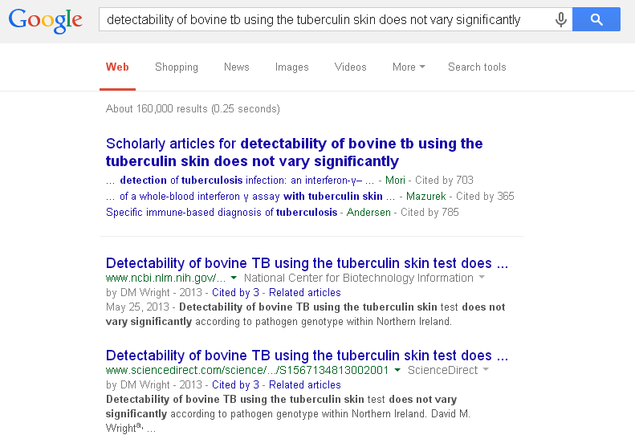


Google and Google Scholar DO NOT always provide complete text
Internet

Slide 14


Libraries vs. Google
Internet

Slide 15
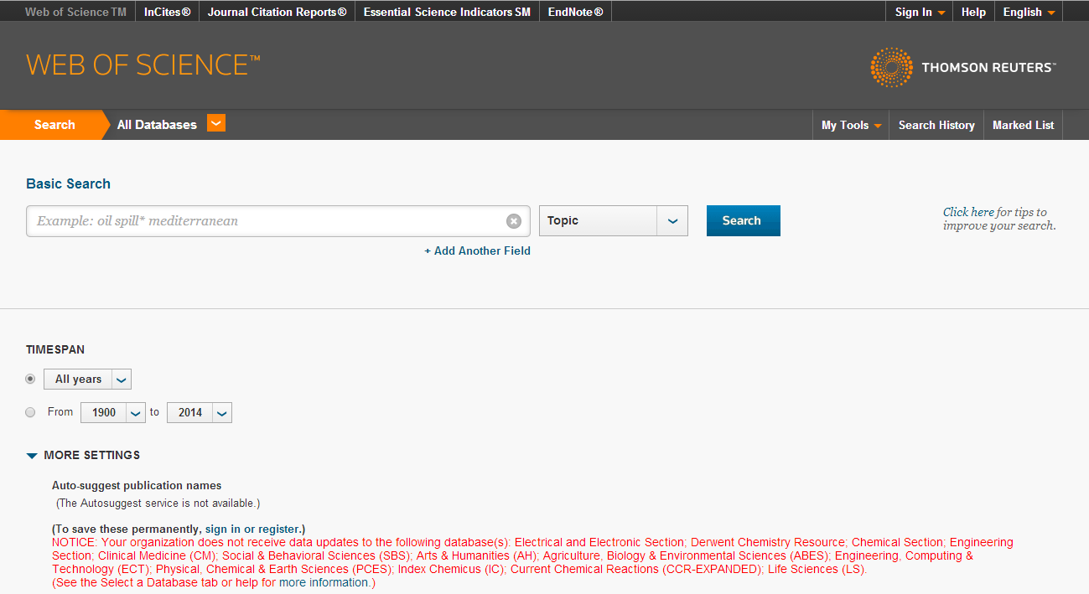
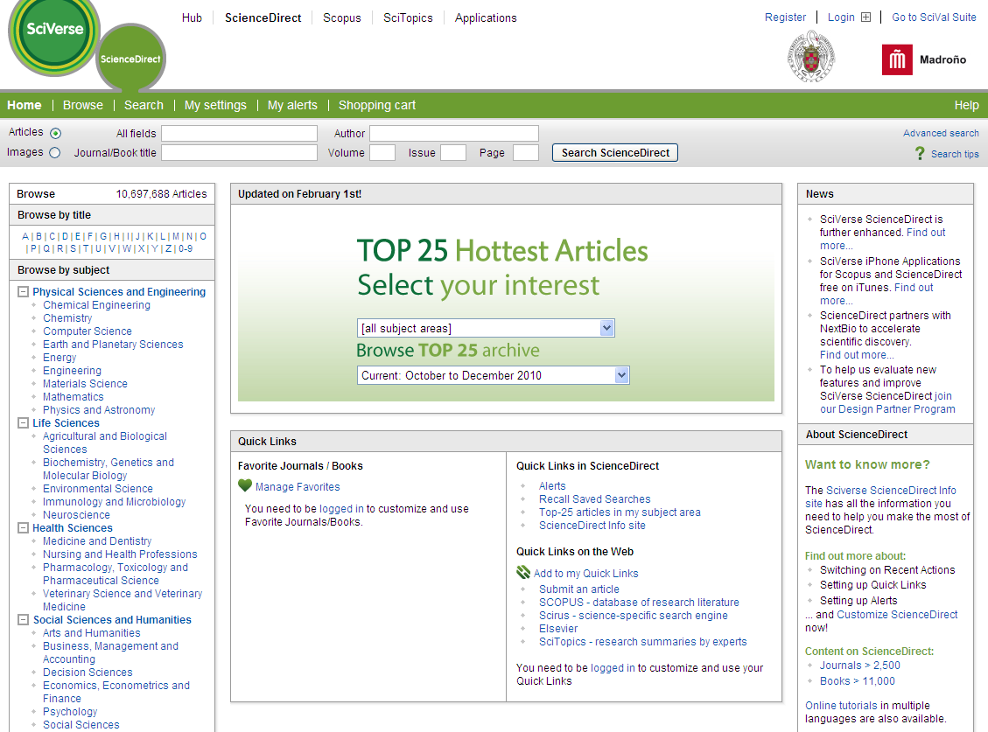
Libraries vs. Google
Internet
ScienceDirect eBook Collection
ScienceDirect Journals

Slide 16
Sources of information
Searching Strategies
How to organize information
Information Evaluation
Internet: Google
Library Websites
Bases de datos
E-journals

Slide 17
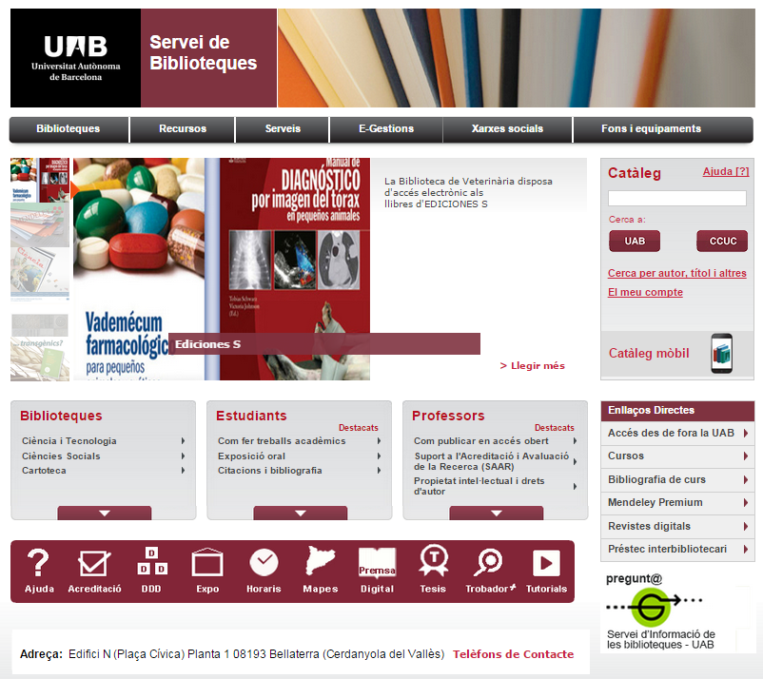
UAB website
Library
Websites
http://www.uab.cat/biblioteques/

Slide 18
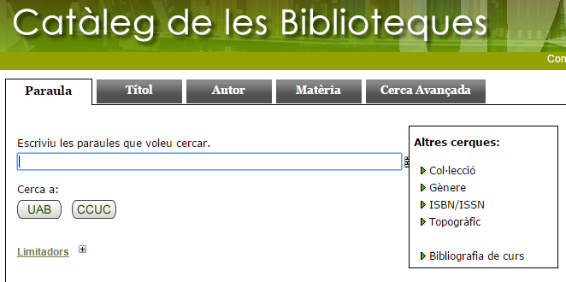
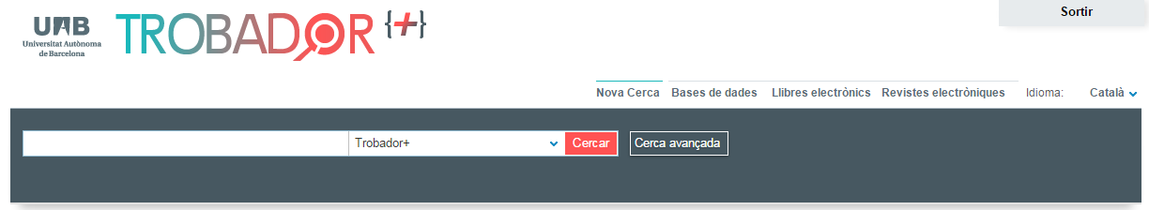
UAB searching tools
Library
Websites

Slide 19
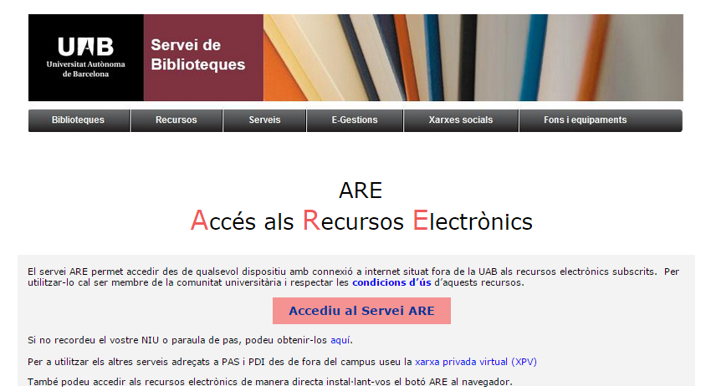
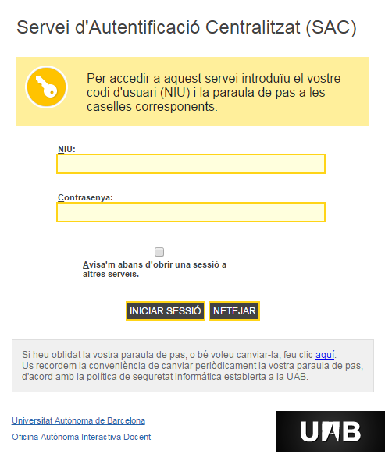

Access from off campus
Library
Websites
New user account requires: name and surname, ID and password
To access remotely we must register as user on

Slide 20
Sources of information
Searching Strategies
How to organize information
Information Evaluation
Internet: Google
Library Websites
Databases
E-journals

Slide 21
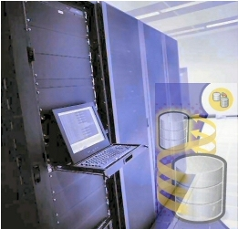
What is a database?
Databases
Data storage system, with tools for information management and recovery.
What can we find in a database?
          Bibliographic references
          Abstracts
          Full text

Slide 22
More used biomedical databases
Databases
Medline/PubMed: Most complete catalogue
Embase: Pharmacology and neuroscience
Cab Direct: Veterinary medicine, animal production, agriculture, nutrition, environmental sciences
Web of Science: Database platform and other associated resources produced by Thomson Reuters.
Scopus: Bibliographic references and cites database of Elsevier
IME (Índice Médico Español ): CSIC biomedical database.
Cochrane Library Plus: Evidence-based medicine, documents for decision-making in medicine, clinical trials, systematic reviews, etc.
FSTA: Nutrition technology

Slide 23

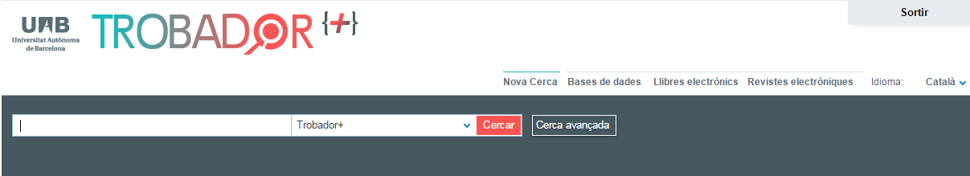
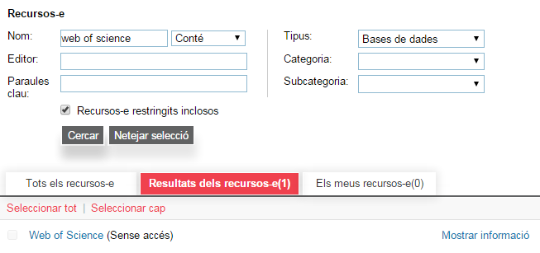
How to access a database?
UAB
Databases
Firstly in we choose options filling later the searching criteria we are looking for. Finally we click on

Slide 24
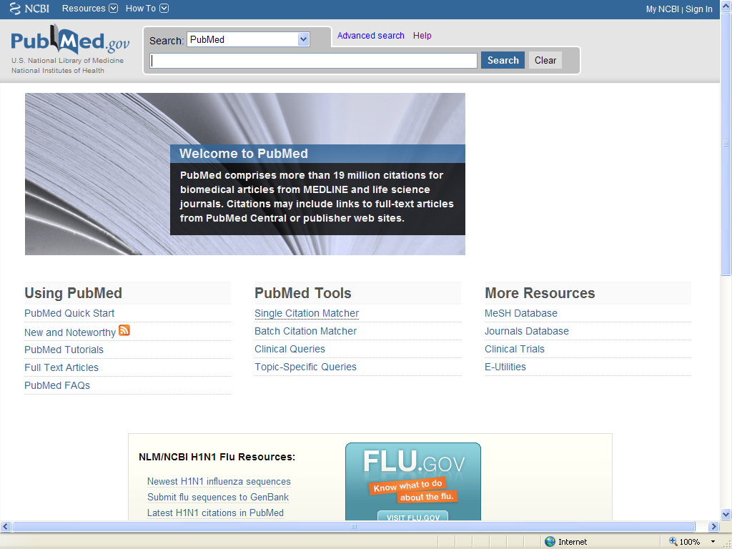

PubMed
Databases
PubMed® Online Training: http://www.nlm.nih.gov/bsd/disted/pubmed.html
http://europepmc.org/

Slide 25
Web of Science
Databases
Access through library or http://www.accesowok.fecyt.es/
Tutorials: http://wokinfo.com/training_support/training/web-of-knowledge/

Slide 26
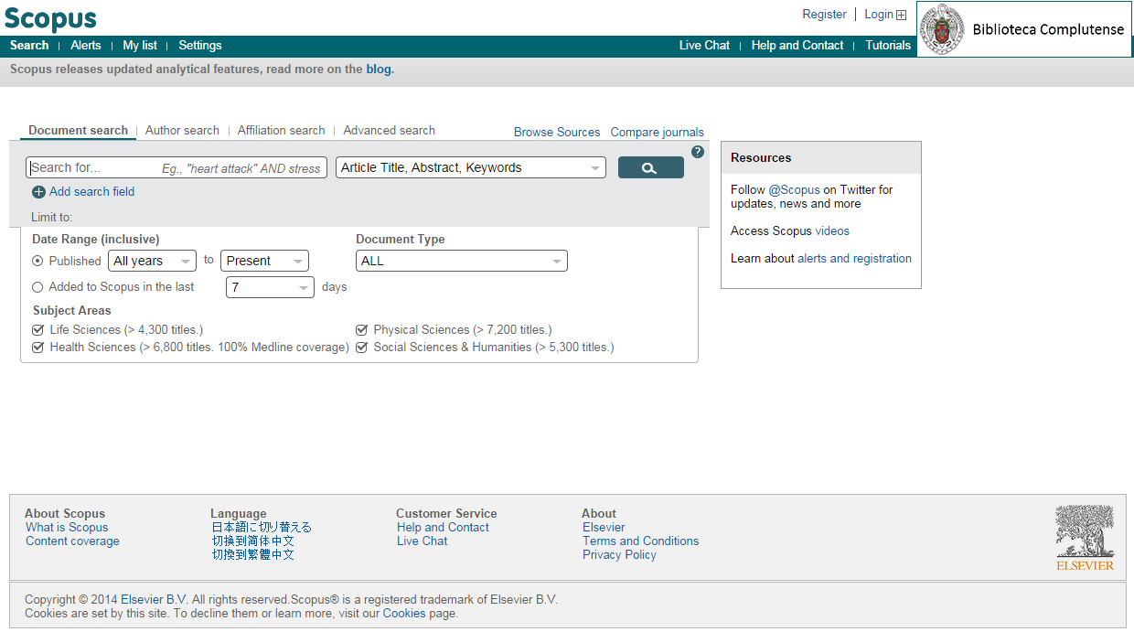
Scopus
Databases
Tutorials: http://help.scopus.com/flare/Content/tutorials/sc_menu.html

Slide 27
Sources of information
Searching Strategies
How to organize information
Information Evaluation
Internet: Google
Library Websites
Databases
E-journals

Slide 28
What is a platform of e-journals?
e-Journals
Collection of e-journals within a single website, including informational resources, tools and services, with a common interface.
Produced by journal editors and distributors
All database functionalities are included:
  Simple and advanced search
  RSS alert
  Export cites
  Pre-published articles optional access(“on line first”, “articles in press”, “early view”…)

Slide 29
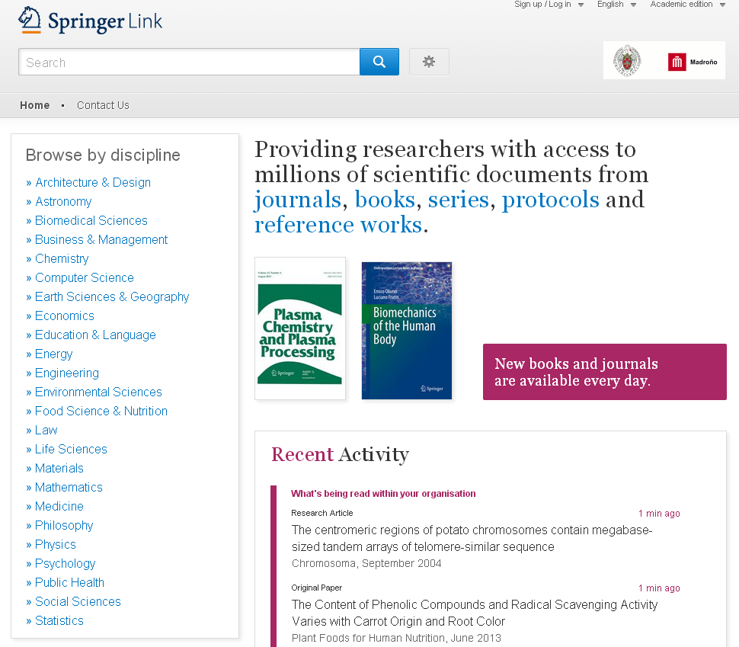

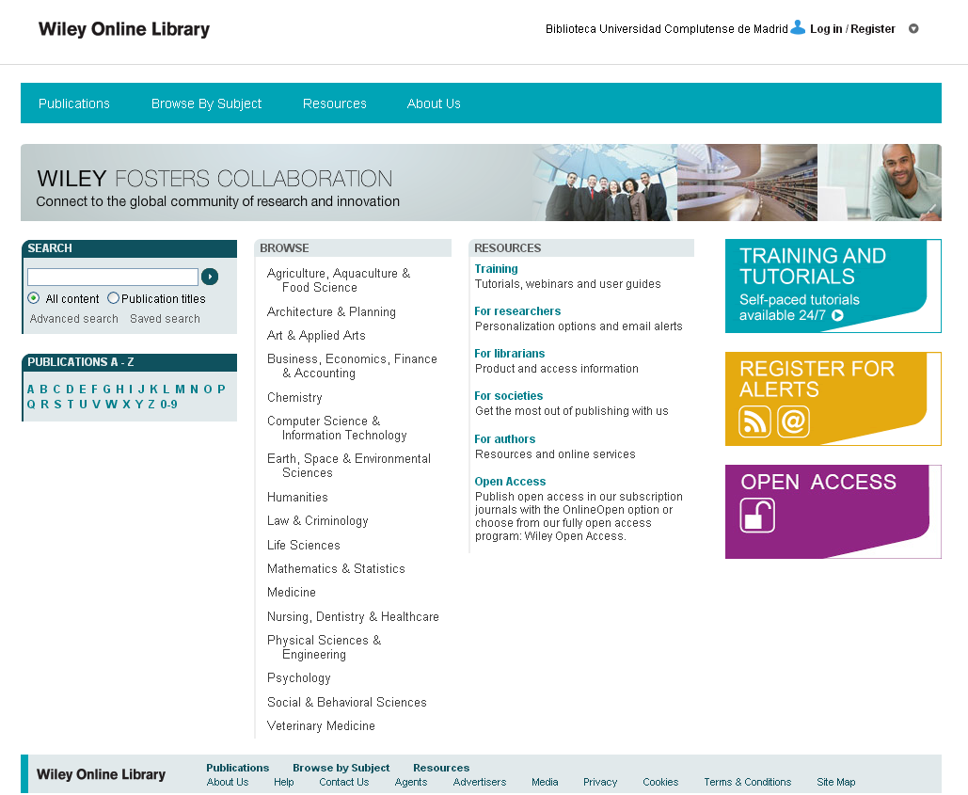

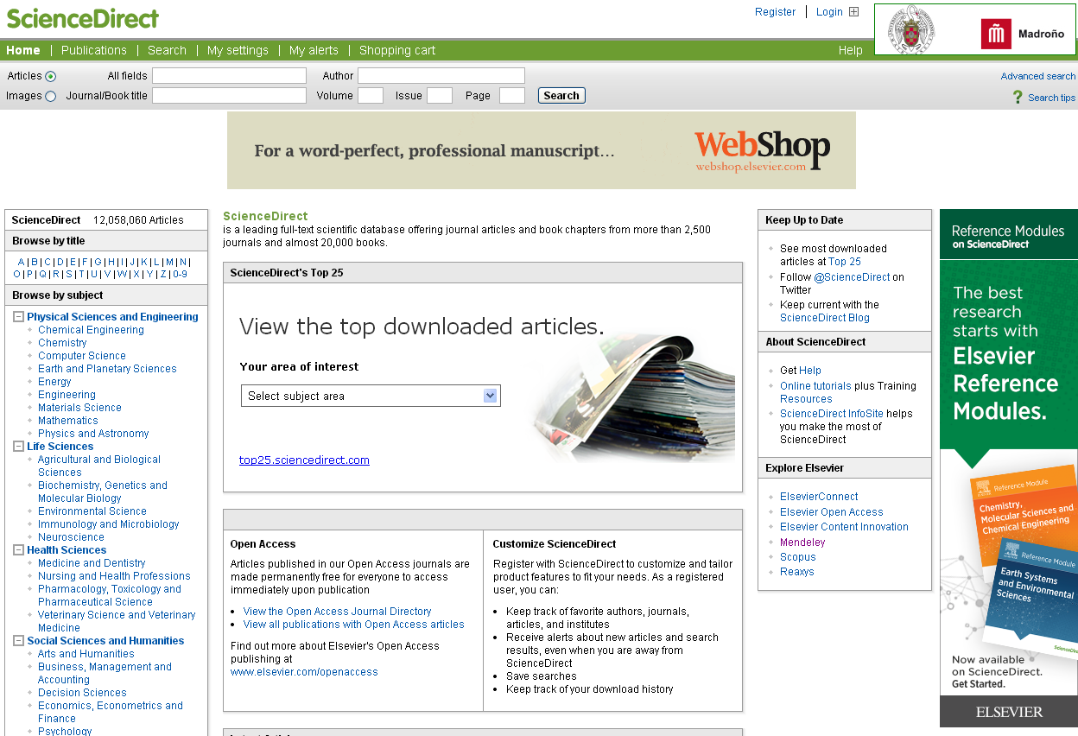

Most important platforms of e-journals
e-Journals

Slide 30
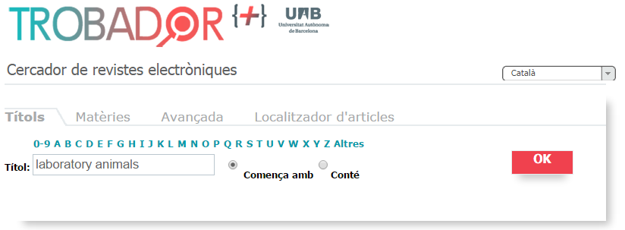
How to access an e-journal? UAB
e-Journals
Firstly we choose on the toolbox , we introduce the searching criteria and we click on

Slide 31
Sources of information
Searching Strategies
How to organize information
Information Evaluation
Keywords
Common language
Descriptors and
Thesaurus
English
Boolean Operators

Slide 32
Searching Strategies:
Basic Recommendations (1)
Searching
Read information related to database content and helping options.
Identify searching criteria (common language).
Take into account language: synonims, technicalities…
Traduce from common to controlled language(thesaurus).
Choose suitable searching options: simple, advanced, by index (authors publications…).
Usage of Booleans (AND, OR, NOT) to combine different criterias
Use truncations * in order to include all roots derivates

Slide 33


What is a thesaurus?
Searching
Hierarchical and alphabetical relationship of words that represent database content of stored documents.
It allows us to find out the most suitable terms to find the information that we are looking for.
http://www.ncbi.nlm.nih.gov/mesh
http://www.hon.ch/HONselect/index_sp.html
http://decs.bvs.br/E/homepagee.htm

Slide 34
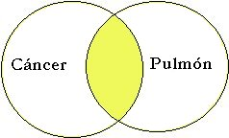
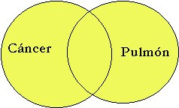
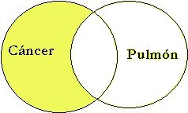
Boolean Operators and truncation
Searching
AND | cancer AND lung | Returns results that include both terms
OR | cancer OR lung | Returns results that include one of the terms
NOT | cancer NOT lung | Returns results that include first term, but no the second
* | cancer* Cancer, cancerous, | Returns results that include root of searching criteria

Slide 35
Searching Strategies:
Basic Recommendations(2)
Searching
Results valuation:
  If numerous:
    Use AND operator
    Less synonimes
    Controlled language (thesarual)
    Concrete terms
    Restricting fields
    Narrow year range
  If few:
    Use OR operator
    Use *
    More synonimes
    Common language
    Generic terms
    Do not restrict fields
    Wide year range
Store and treat relevant results (print ,send via email, export to bibliograpic manager).
Create alerts. RSS.

Slide 36
Sources of information
Searching Strategies
How to organize information
Information Evaluation
Reference Managers

Slide 37

What is a Reference manager?
Reference
Manager
A reference manager is an application that allows us to create our own database with our own documents.
It also allows to capture, archive and organize documents and bibliographic references and edit and insert those references on a document with different formats.

Slide 38
Functionalities
Reference
Manager
Automate reference integration from databases, etc.
Edit, classify, order, archive and manage references
File storage associated to references
Information sharing with other people and groups
Produce bibliography from other groups of references.
Cites and references insertion on text documents.
Cites and references format edition according to different standards

Slide 39
Main reference managers
Reference
Manager

Slide 40
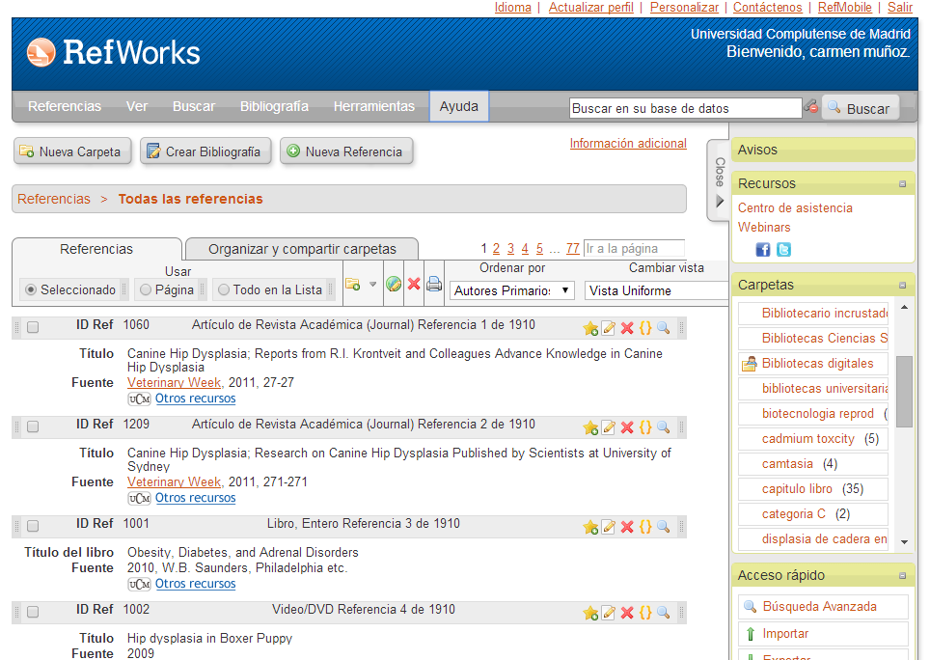
RefWorks
Reference
Manager
Online payment service, taken out by UCM and UPM.
Ease all manager system functionalities allowing remote access without installation through a PIN that allow usage out of campus
It is also possible to import references and attach documents, produce bibliographies, references and cites edition, RSS source management, reference sharing, etc.
http://www.refworks.com/refworks

Slide 41
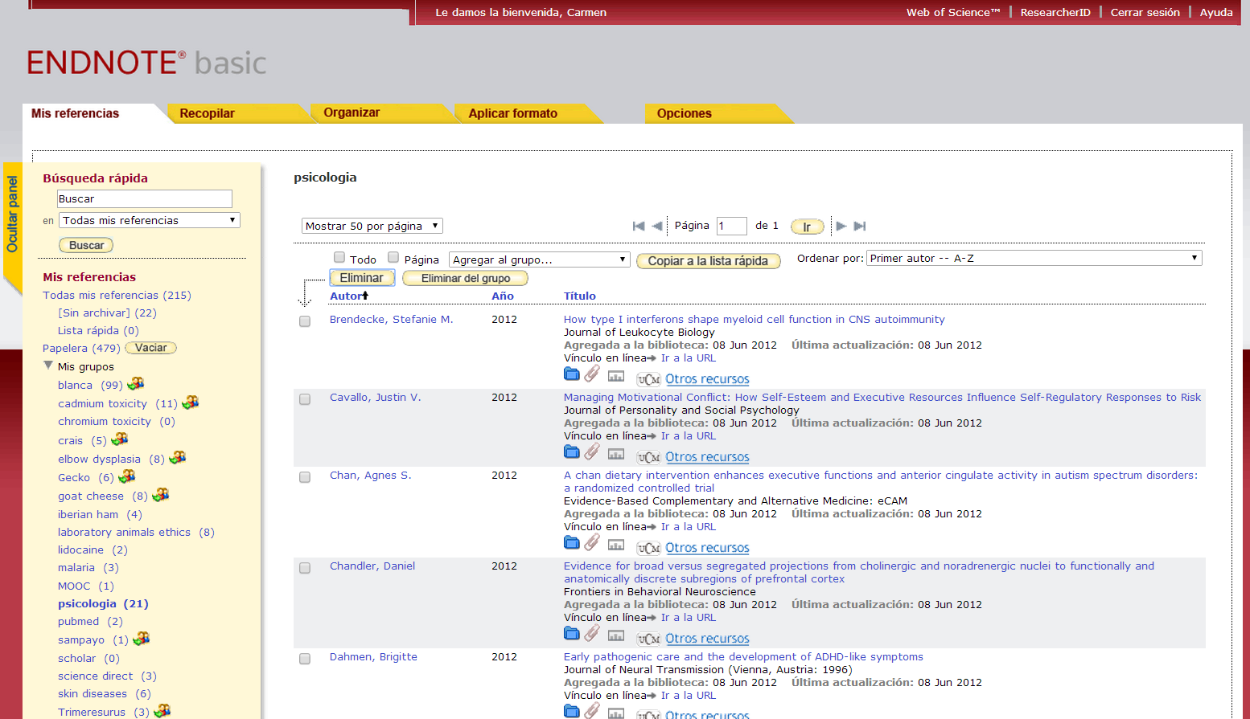
EndNote basic
Reference
Manager
Online payment service, associated to Web of Science database
There is also a free version, but with limited functionalities
Cloud-based content.
It is also possible to import references and attach documents, produce bibliographies, references and cites edition, RSS source management, reference sharing, etc.
https://www.myendnoteweb.com/

Slide 42
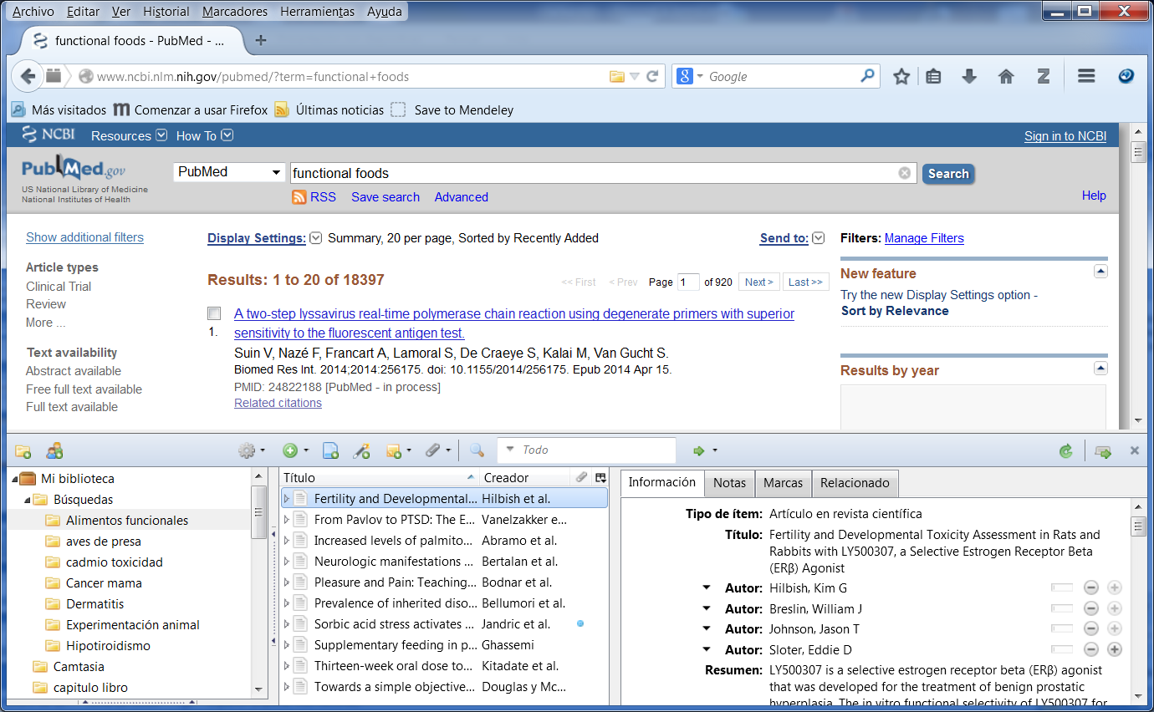
Zotero
Reference
Manager
Free software client installation as Firefox and Chrome add-on or single software entity. It is able to syncronize with online service
We can easily capture references and documents directly from a website, produce bibliography,cites and reference insertion on text document and it also has document sharing and collaboration functionalities.
http://www.zotero.org/

Slide 43
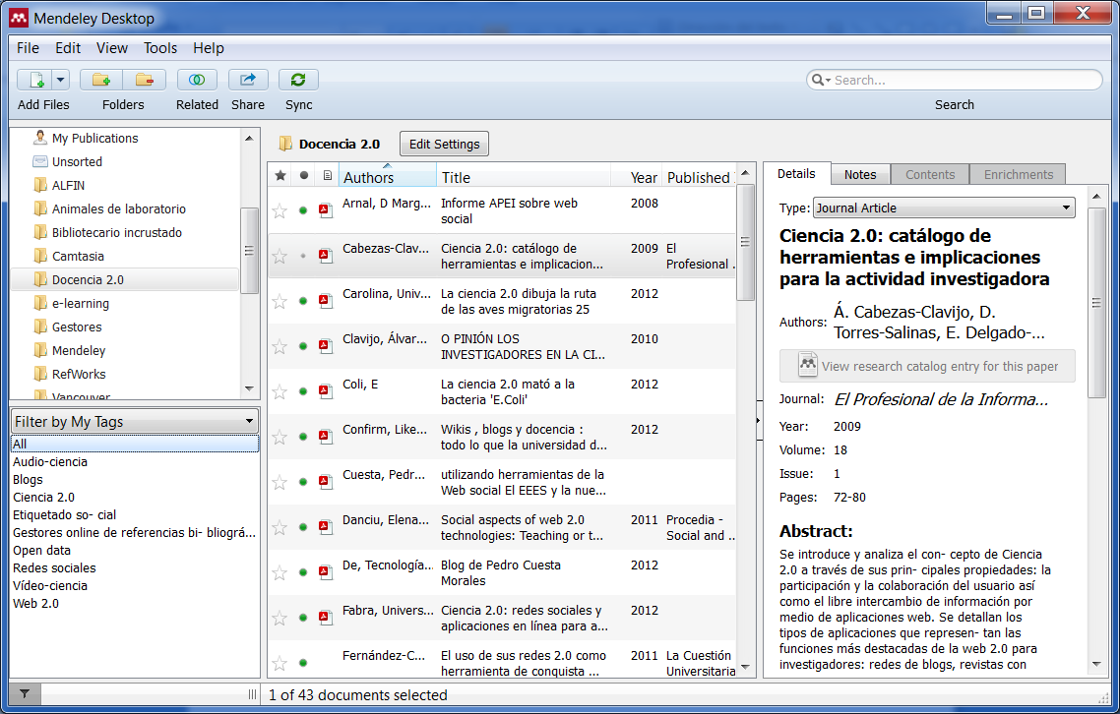
Mendeley
Reference
Manager
Reference manager and
academic social network software client available for PC or mobile devices that syncronizes with a online service.
Software is free, but for advanced functionalities premium and institutional versions have additional cost
It allows import references and documents, produce bibliography, cites and reference edition and information sharing with colleagues and groups
Specially useful for PDF document management.
http://www.mendeley.com/
Mendeley Premium (UAB)
http://www.uab.cat/biblioteques/mendeley/

Slide 44
Sources of information
Searching Strategies
How to organize information
Information Evaluation
Bibliometric Indicators

Slide 45
Bibliometric Indicators
Metrics
Cites indicators:
  Web of Science (Science Citation Index)
  Scopus
  Google Scholar
JCR impact indicators:
  Impact Factor
  Complementary indicators to impact factor: immediacy index, expectance, quartile, Eigenfactor, Article influence
Other: h index, SJR, SNIP
Other Spanish index: In-Recs, In-Recj, Resh, Potential Impact Factor of Spanish Medical Journal
Notes:
45

Slide 46



Cite Indicators:
Web of Science
Metrics
Reference database for biomedical bibliometric indicators
Produced by
Coverage Science Citation Index: 1900 up to date, 8658 journals
Insititutional subscription access granted
by and
http://www.accesowok.fecyt.es/
Notes:
46

Slide 47
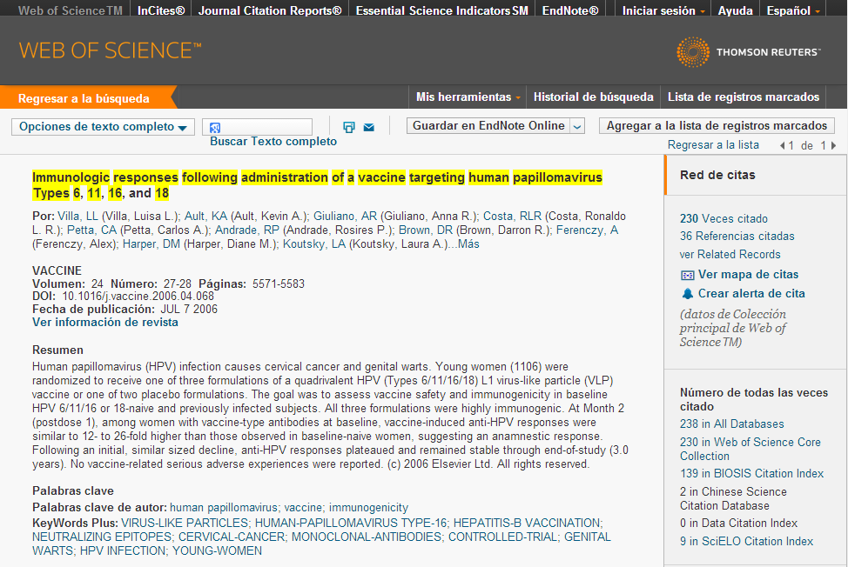
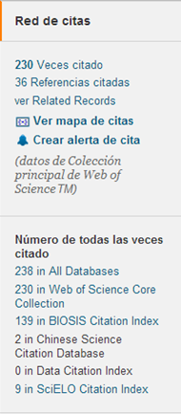
Cites Indicator:
Web of Science
Metrics
Advantages:
Multidisciplinary.
Scientific quality journal selection criteria.
Total articles download of selected journals
Always include documents authors
Author information included: working institution, city and country.
Contains document bibliographic references.
Constraints:
Language and geographical slant.
Notes:
47

Slide 48
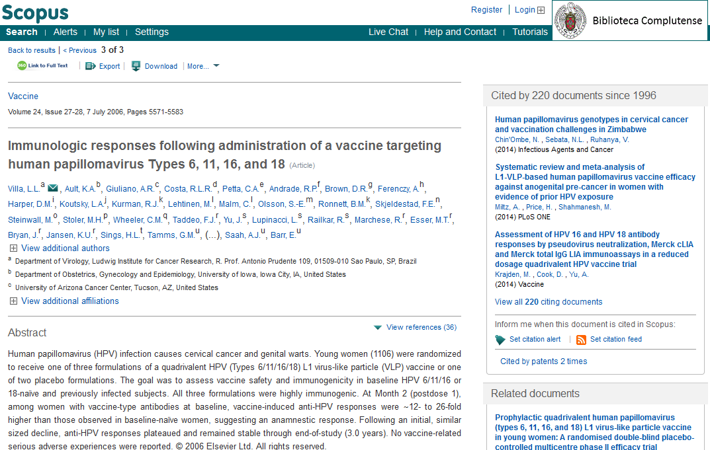
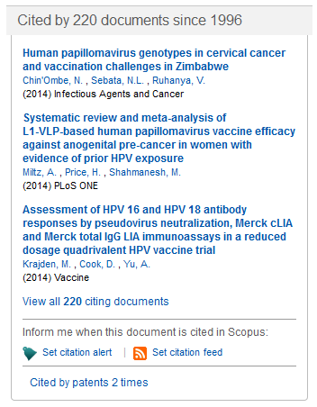
Cites Indicator:
Scopus
Metrics
Developed by Elsevier .
Less cite coverage in comparisson with Web of Science
Includes more records not based in English language than Web of Science.
Scopus includes more journals with faster cites analysis than Web of Science; however such analysis is less exhaustive
Notes:
48

Slide 49
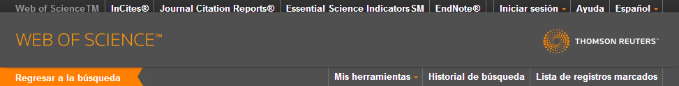
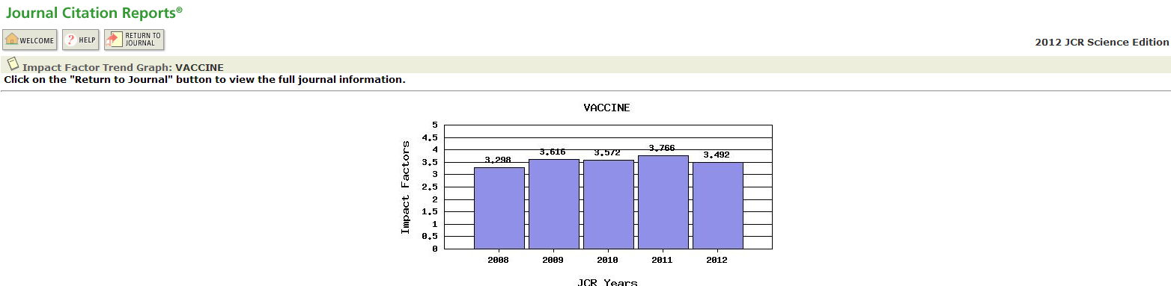
Journal of Citation Reports
Metrics
journal IF indicator : average number of times in a given year that articles published in this journal have been cited during the previous two years.
Engined by Eugene Garfield, founder of Institute for Scientific Information (ISI) in 1955.
You can access through database within the forenamed platform
Yearly upgrade (June/July)
Includes publications from 1997 onwards
Notes:
49

Slide 50


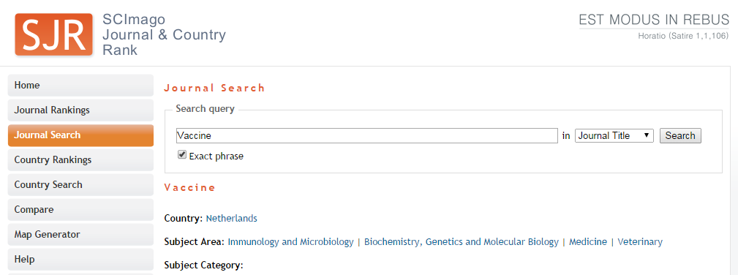
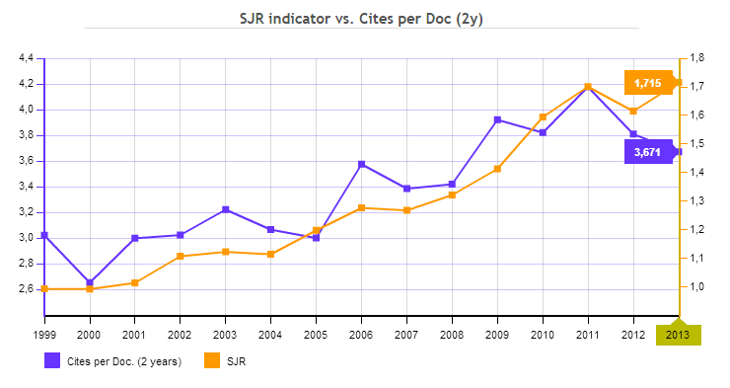
Scimago Journal Rank
Metrics
SJR (Scimago Journal Rank) is an impact index similar to JCR based on Scopus.
Three year cites based analysis
SJR provide higher value to high standard magazines using PageRank algorithm for the calculation
Accessible through or
Notes:
50

Slide 51


H index
Metrics
      Hirsch, J. E. (2005). A bibliometric index to quantify production of an individual researcher. Proceedings of the National Academy of Sciences of the United States of America,
      102(46), 16569-16572.
The h index is a measuring system of quality physicians and other scientists proposed by Jorge E. Hirsch, University of California, based on the number of citations receiving a scientific paper scientists.
It was designed for accurately measure the quality of a researcher, the main difference is that it takes into account the most cited scientifics vs. Other measurements that simply show the ones that publish more
A scientist has h index if has at least h publications with at least h citations each one representing the balance between number of publications and citations of them.
You can access thorugh and .
Notes:
51

Slide 52
H index
Metrics
H=20 → Successful career after 20 years researching
H=35-45 → Top scientists
H=60 → Outstanding scientists
Samples:
  Ed Witten (Princeton Physics) → h=130
  Manuel Cardona (Experimental Physics) → h=104
  Physis Nobel Award average H index→ h=41
  Physical access to the Academy of Sciences of the United States H index required→ h=45
Notes:
52

Slide 53
Highlights
¿How to access a full text articles?
Recommended steps:
Search for article on Trovador+.
If article was not found, search by journal title on UAB library catalogue.
If journal subscription is not available, search by article title on Google and Google Scholar.
If we could not download a full text article, we open a formal request through Interlibrary Loan Service.

Slide 54
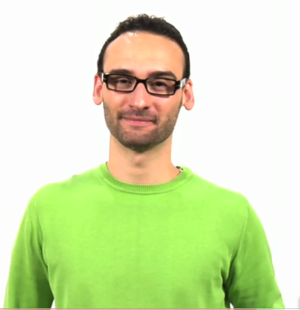
before concluding...
  http://www.youtube.com/watch?v=iwPj0qgvfIs&feature=youtu.be&a

Slide 55

Questions?
Mar Sanz
msanz@buc.ucm.es

Slide 56

Thank you!

Slide 57


